Slide 1
Adding a new course

Slide 2
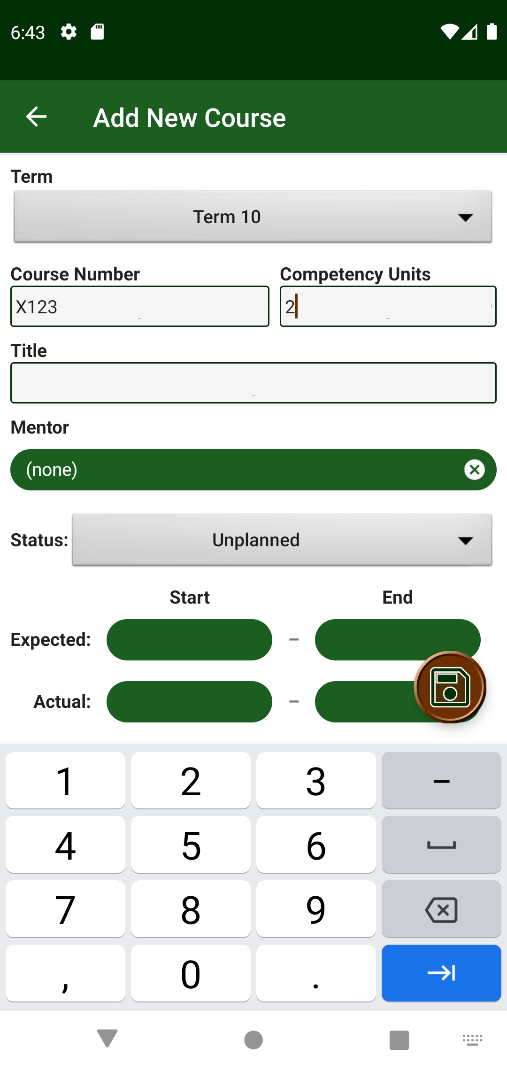
When adding a new course, the mentor is selected by clicking on the “Mentor” chip

Slide 3
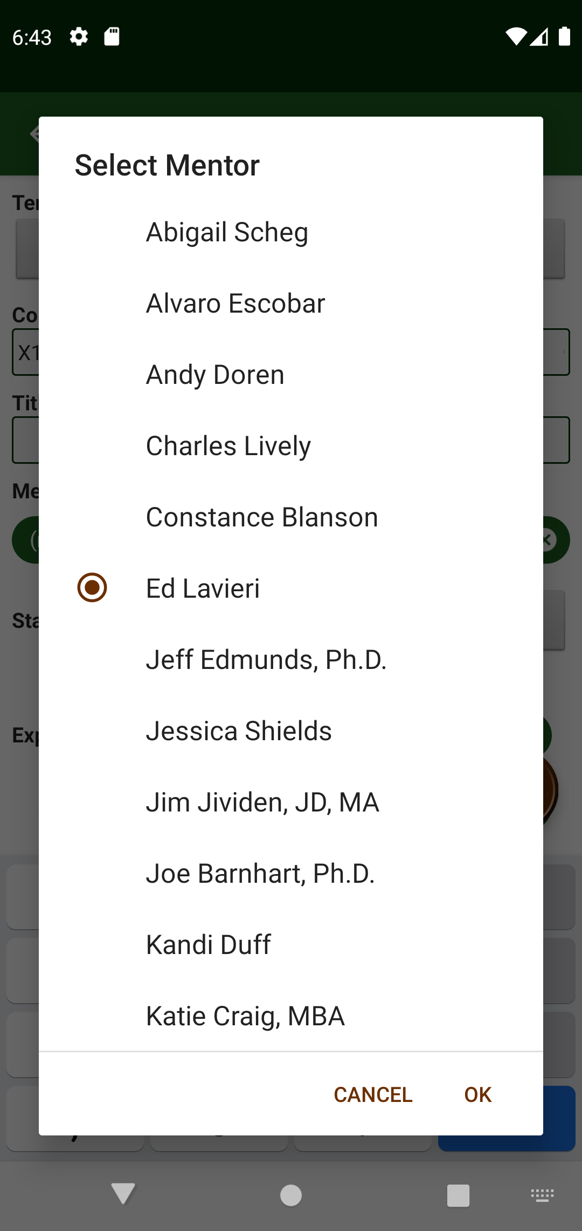
Select from mentors, which had been added from root “Mentors” activity

Slide 4

Selected mentor’s name appears in text of chip

Slide 5
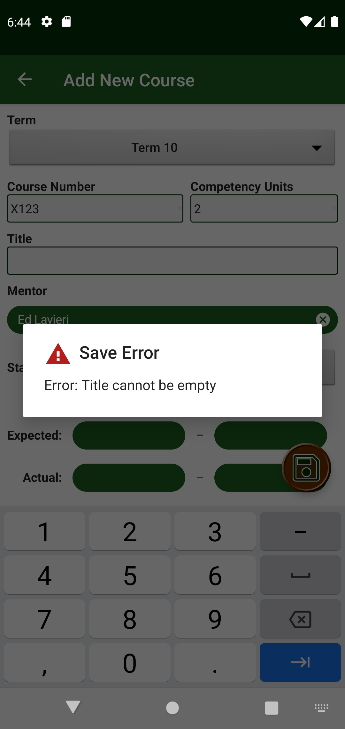
Attempting to save without filling in other required fields, will result in error message.

Slide 6
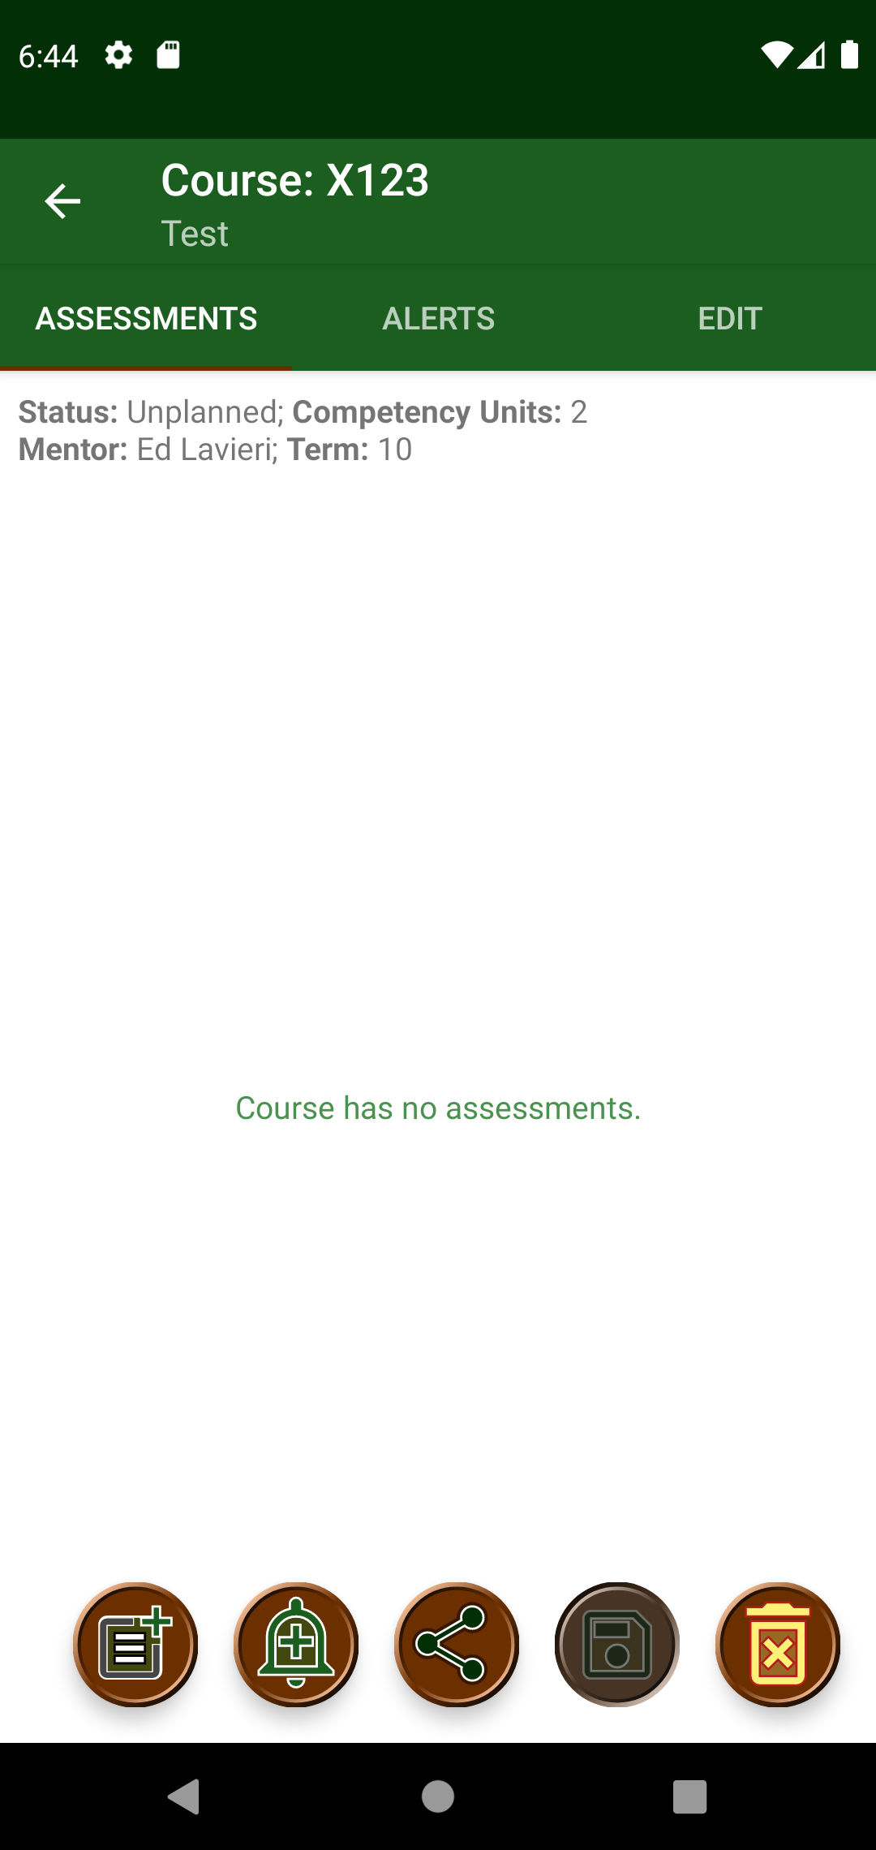
After mentor is saved, the edit mentor activity is presented. Save button is disabled since there are no changes to save at this point.

Slide 7
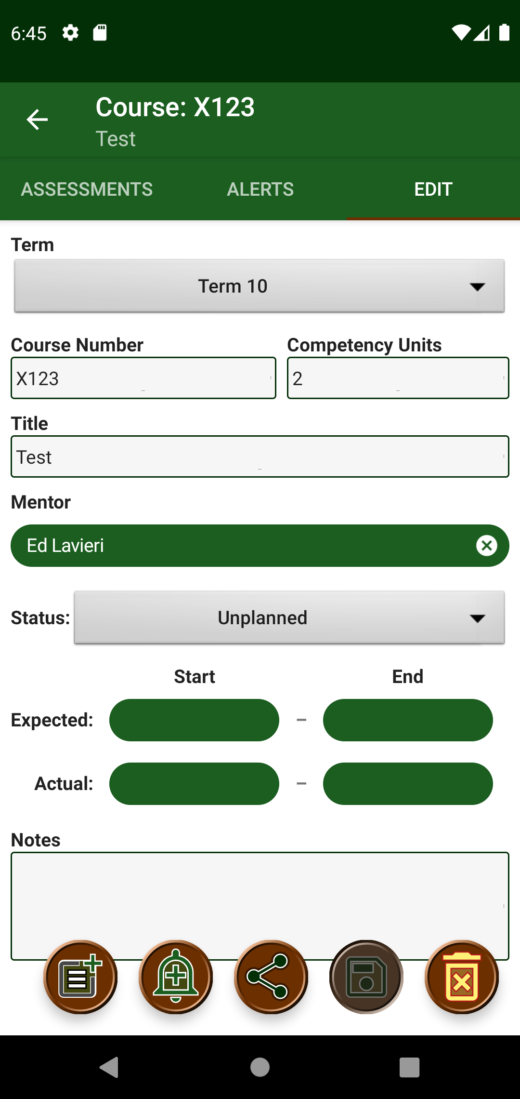
Mentor can be changed by switching to “Edit” tab and clicking on the “Mentor” chip

Slide 8
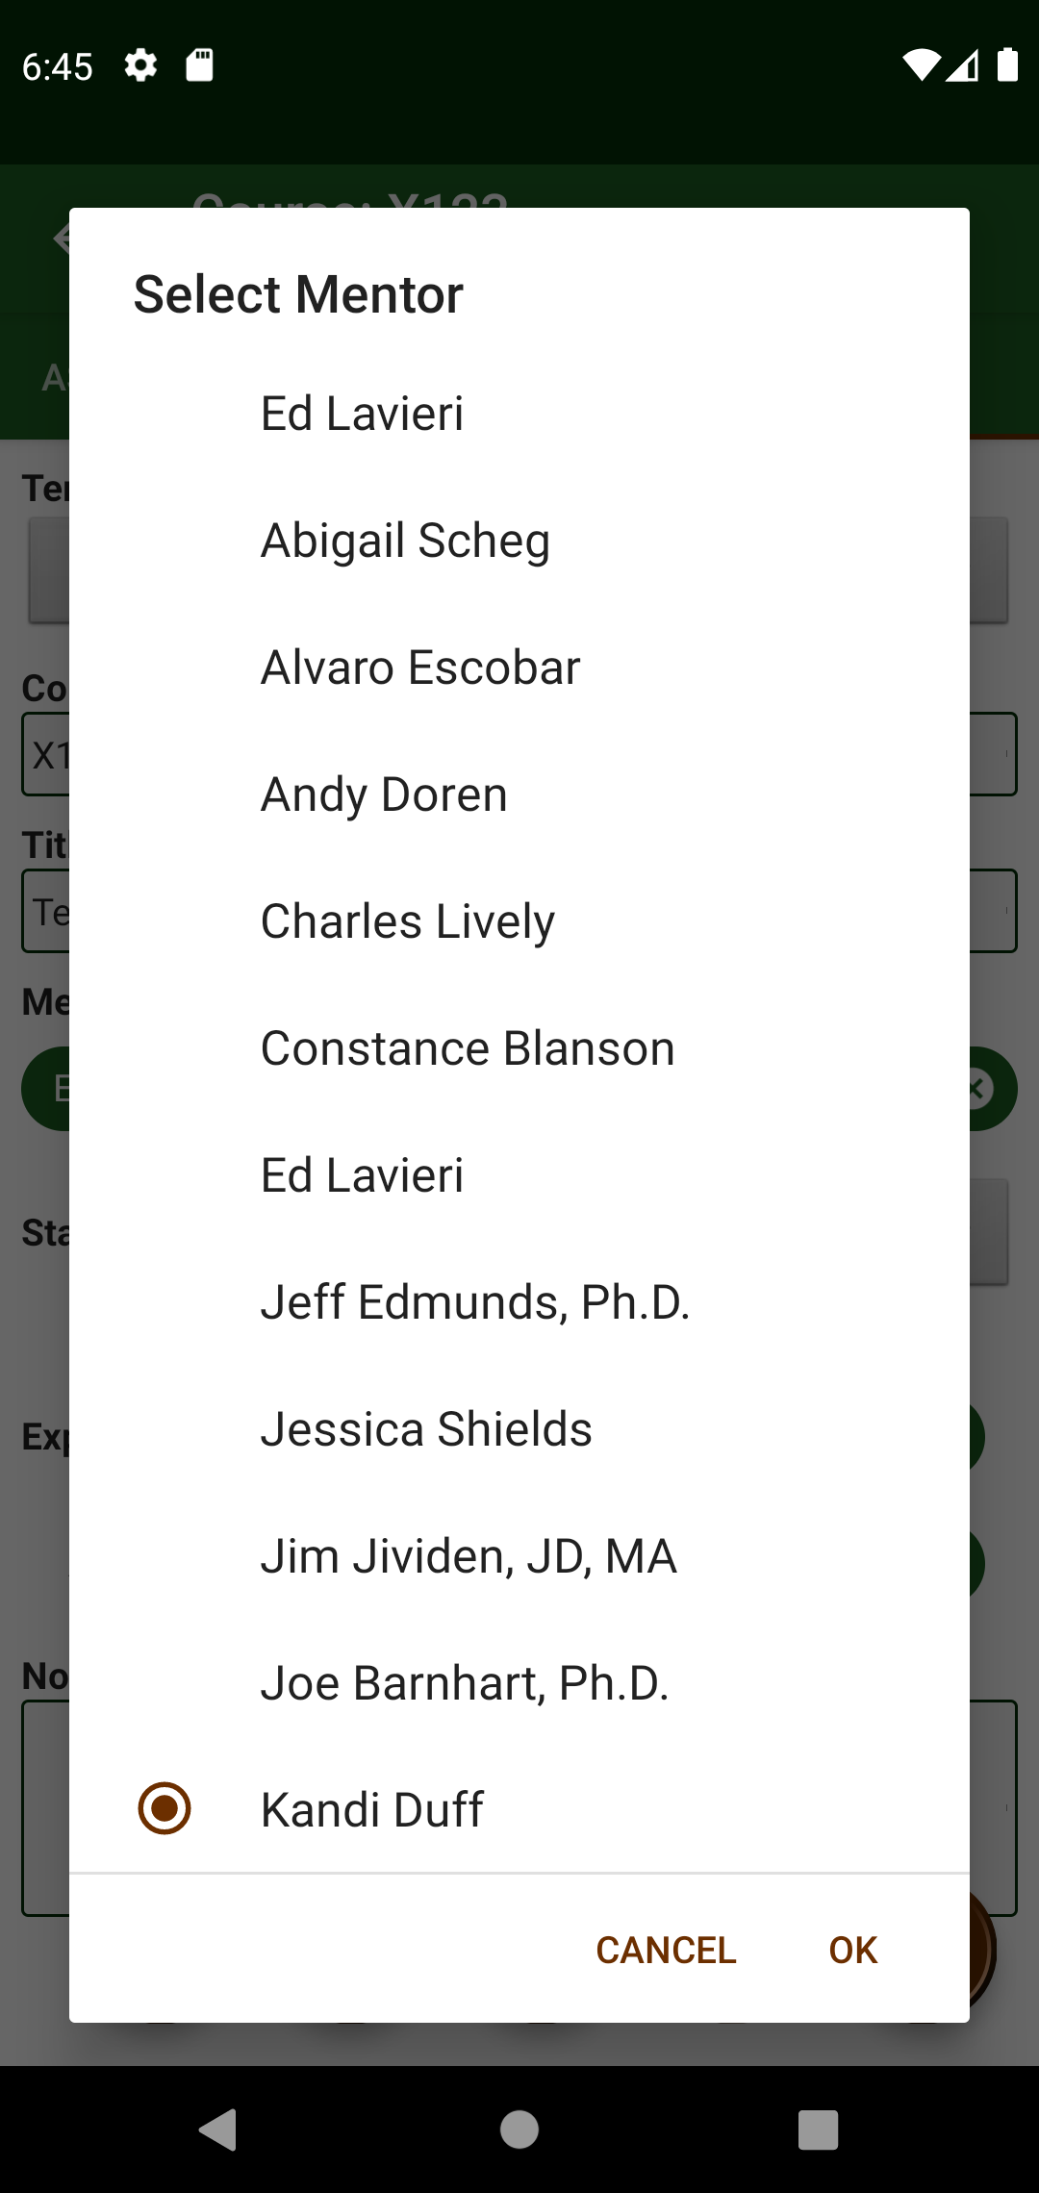
A different mentor is selected by clicking on the “Mentor” chip and selecting from the dropdown.

Slide 9
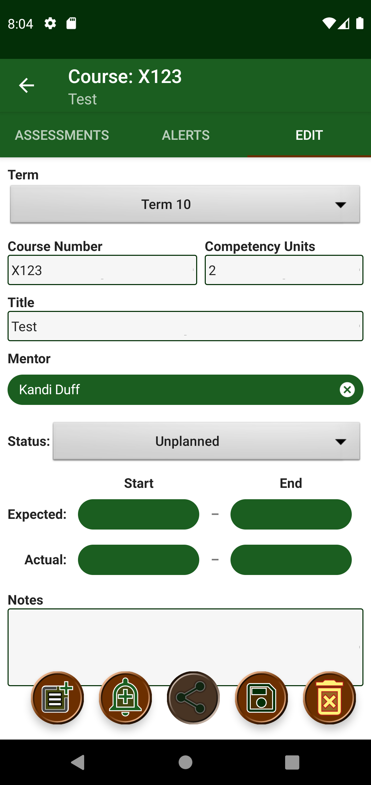
Save button is now enabled. Share button is disabled if there are unsaved changes.

Slide 10
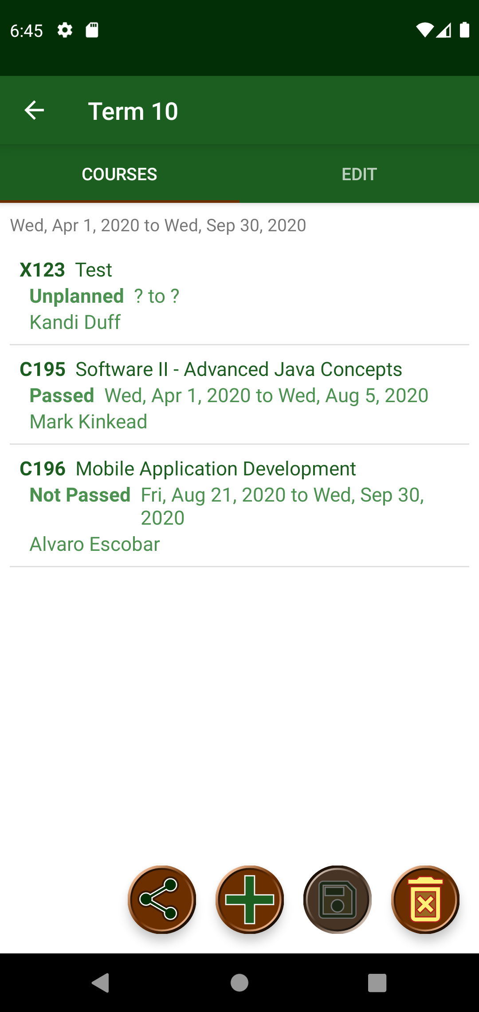
View Term Activity is presented after saving changes to a course.

